Slide 1
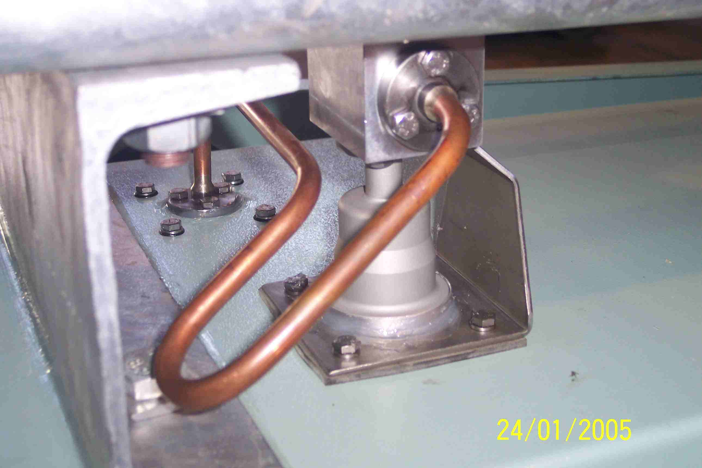
SIEMENS
HVCB SPARES
Small Gas pipe-1, 72.5KV/145KV, 40KA CB
S4804928002

